Slide 1
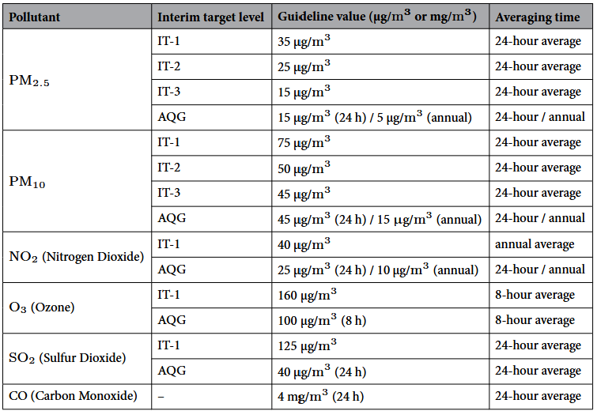
Grenzwerte – WHO Air Quality Guidelines

Slide 2
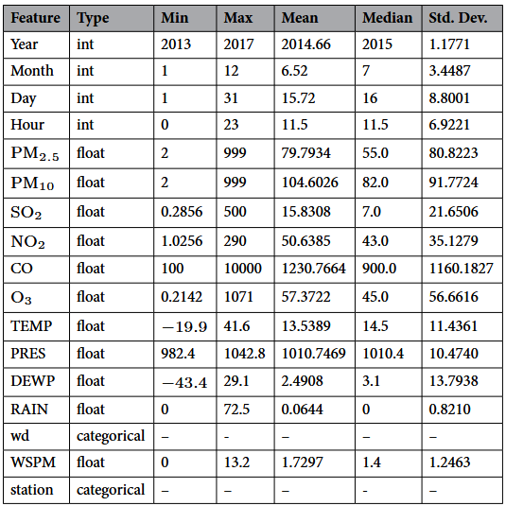
Dataset statistics

